Slide 1

FINAL DEFENSE
Barangay Vehicle Management System
Keeping emergency response vehicles ready, repaired and accountable
Capstone Project | October 2026
Notes:
Introduce the project: a web-based system that tracks readiness and maintenance of the barangay's emergency vehicles.

Slide 2
02 INTRODUCTION
Project overview
A web-based system that tracks whether each barangay emergency vehicle (ambulance, fire truck, rescue boat and others) is ready to respond, and manages the repair process that keeps it that way, from reported issue to verified return to service.
2
questions it answers
Can this vehicle be dispatched now? What keeps it serviceable?
3
user roles
Admin, Custodian and Maintenance Personnel (one role per account)
Built as a Laravel REST API with a React single-page app, a MySQL database and Supabase file storage.
2
repair routes
In-house mechanic or external repair shop

Slide 3



03 THE PROBLEM
Problem statement
Emergency vehicles are used only when disaster strikes, yet the barangay cannot say, with proof, which of them can respond right now, or who is responsible for fixing the ones that cannot.
No single view of readiness
Issues are reported informally
Availability and condition are scattered across memory, chats and paper logs.
Verbal reports get lost, carry no severity or evidence, and are never tracked to closure.

Slide 4
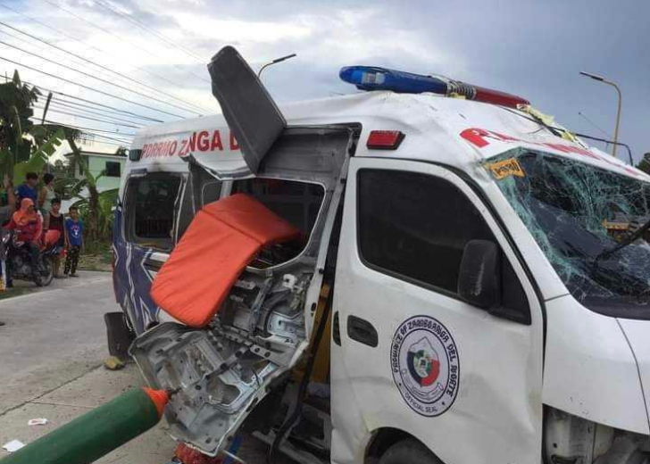
03 THE PROBLEM (1 OF 2)
Problem statement: the evidence
1 in 3
Filipinos view poor maintenance of vehicles as a primary cause of road accidents (33% of 1,418 respondents).
Poor vehicle maintenance is a safety risk to the public, and for emergency units it is also a risk to the people they are sent to save.
An emergency responder died and three others were injured when their ambulance rolled over after it blew a tire on the national highway in Argao, Cebu (June 13).
Sources: Cebu Daily News, "Argao ambulance accident: emergency responder dead, 3 others hurt" (photo: Argao MDRRMO via Paul Lauro). WR Numero Research, Philippine Public Opinion Monitor, Issue 4, Vol. 2025 (n = 1,418; 29 Jul to 6 Aug 2025; margin of error ±2%).
Notes:
Sources: cebudailynews.inquirer.net/578615/argao-ambulance-accident-emergency-responder-dead-3-others-hurt ; WR Numero Philippine Public Opinion Monitor, Issue 4 Vol 2025.

Slide 5
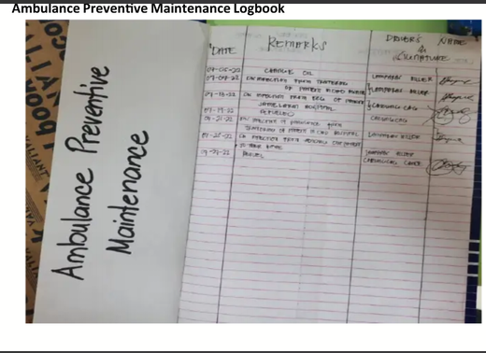
03 THE PROBLEM (2 OF 2)
Problem statement: the evidence
When a barangay truck needed servicing, the mechanic it called mostly did not show up.
Commission on Audit finding on the 90 trucks Zamboanga City gave to its barangays (Malaya)
COMMISSION ON AUDIT FINDING, CEBU CITY
Barangay vehicles were not covered by a duly accomplished trip ticket.
Preventive maintenance today: a handwritten logbook of dates, remarks and signatures.
COA audit of Cebu City barangay vehicles (Inquirer, 2011). PCSO adds that once an ambulance is donated, its maintenance becomes the receiving LGU’s responsibility (Manila Times, 2018).
Sources: Malaya, "COA questions Zamboanga City’s purchase of 90 garbage collection vehicles"; Philippine Daily Inquirer, "Suspend fuel shares to brgys, execs told" (newsinfo.inquirer.net/46423); Manila Times, "LGUs should repair, maintain ambulances – PCSO" (May 4, 2018); ambulance preventive maintenance logbook photo.
Notes:
Sources (open and verify the wording before presenting; the pages could not be opened automatically): malaya.com.ph/news/coa-questions-zamboanga-citys-purchase-of-90-garbage-collection-vehicles ; newsinfo.inquirer.net/46423/suspend-fuel-shares-to-brgys-execs-told ; pressreader.com/philippines/manila-times/20180504/281775629782158. Point to make: barangay vehicles have no tracked record of defects or repairs, so problems are not followed up. The logbook photo is the team's own evidence of today's paper process.

Slide 6

04 WHAT THE SYSTEM SOLVES
Proposed solution
The VMS replaces guesswork with one controlled workflow: every vehicle has a clear status, and every repair has an owner, an approval and proof.
PROBLEM
HOW THE VMS SOLVES IT
Which vehicles can respond now?
Availability and condition tracked separately, with a readiness dashboard and condition monitoring
Issues get lost
Structured issue reports with vehicle, severity and evidence, turned into maintenance tickets

Slide 7






05 GOALS
Project objectives
General objective Design and build a web-based system that keeps barangay emergency vehicles ready to respond through managed maintenance.
Maintain a fleet inventory
Track readiness
Run a controlled ticket workflow
Vehicle profiles, types, documents and station locations
Availability and condition per vehicle, with fleet intelligence
Report, propose, approve, repair, verify, close
Schedule preventive maintenance
Enforce roles and an audit trail
Report and notify
Recurring schedules and maintenance records
Role-based access, separation of duties, activity log
Reports, notifications and archived tickets

Slide 8


06 BOUNDARIES
Scope and delimitations
In scope
Delimitations (out of scope)
Fleet inventory and vehicle profiles
Availability and condition, tracked independently
Issue reporting, tickets, repairs, verification, closure
Preventive and recurring maintenance schedules
Readiness checks and fleet intelligence
Vehicle station locations (hubs)
Operations and dispatch
Who drove where on a call is not recorded.
Document compliance
Registration, insurance and permit expiry are not tracked.
Mileage-based servicing
Odometer readings do not drive maintenance.
Real-time GPS tracking
Only the station (hub) of each vehicle is recorded.
Native mobile apps
The system is web-based only.

Slide 9



07 WHO USES IT
Target users
Admin
Custodian
Maintenance Personnel
Approves or declines tickets and shop jobs
Assigns maintenance personnel
Manages fleet, accounts and reports
Creates accounts with temporary passwords
Reports issues and registers vehicles
Proposes tickets; logs jobs sent to the shop
Receives and tests the repair, then closes the ticket
Monitors condition; adds types and locations
Executes assigned repairs
Logs work, parts used and donor parts
Submits work orders for verification
Views every vehicle in the barangay

Slide 10
08 PROCESS
Ticket flow: in-house and external shop
1 Report issue
Custodian, with severity and evidence
2 Propose ticket
Custodian picks route and repair lines
3 Admin review
Approve, or decline with reason
Approved: repair route set at proposal
IN-HOUSE
Admin assigns the mechanic (Custodian may suggest)
Mechanic repairs, logs work and parts
Custodian verifies the completed repair
4 Outcome
Satisfactory: ticket closes. Not satisfactory: rework
EXTERNAL SHOP
Custodian logs the shop job; Admin approves it
Custodian sends the vehicle and records its return
Custodian tests it, then verifies and closes
Disapproved returns the ticket for rework with a reason. A mechanic cannot verify their own repair.
Closed and archived
Notes:
Walk through the shared steps first, then the two repair routes, then verification and closure.

Slide 11
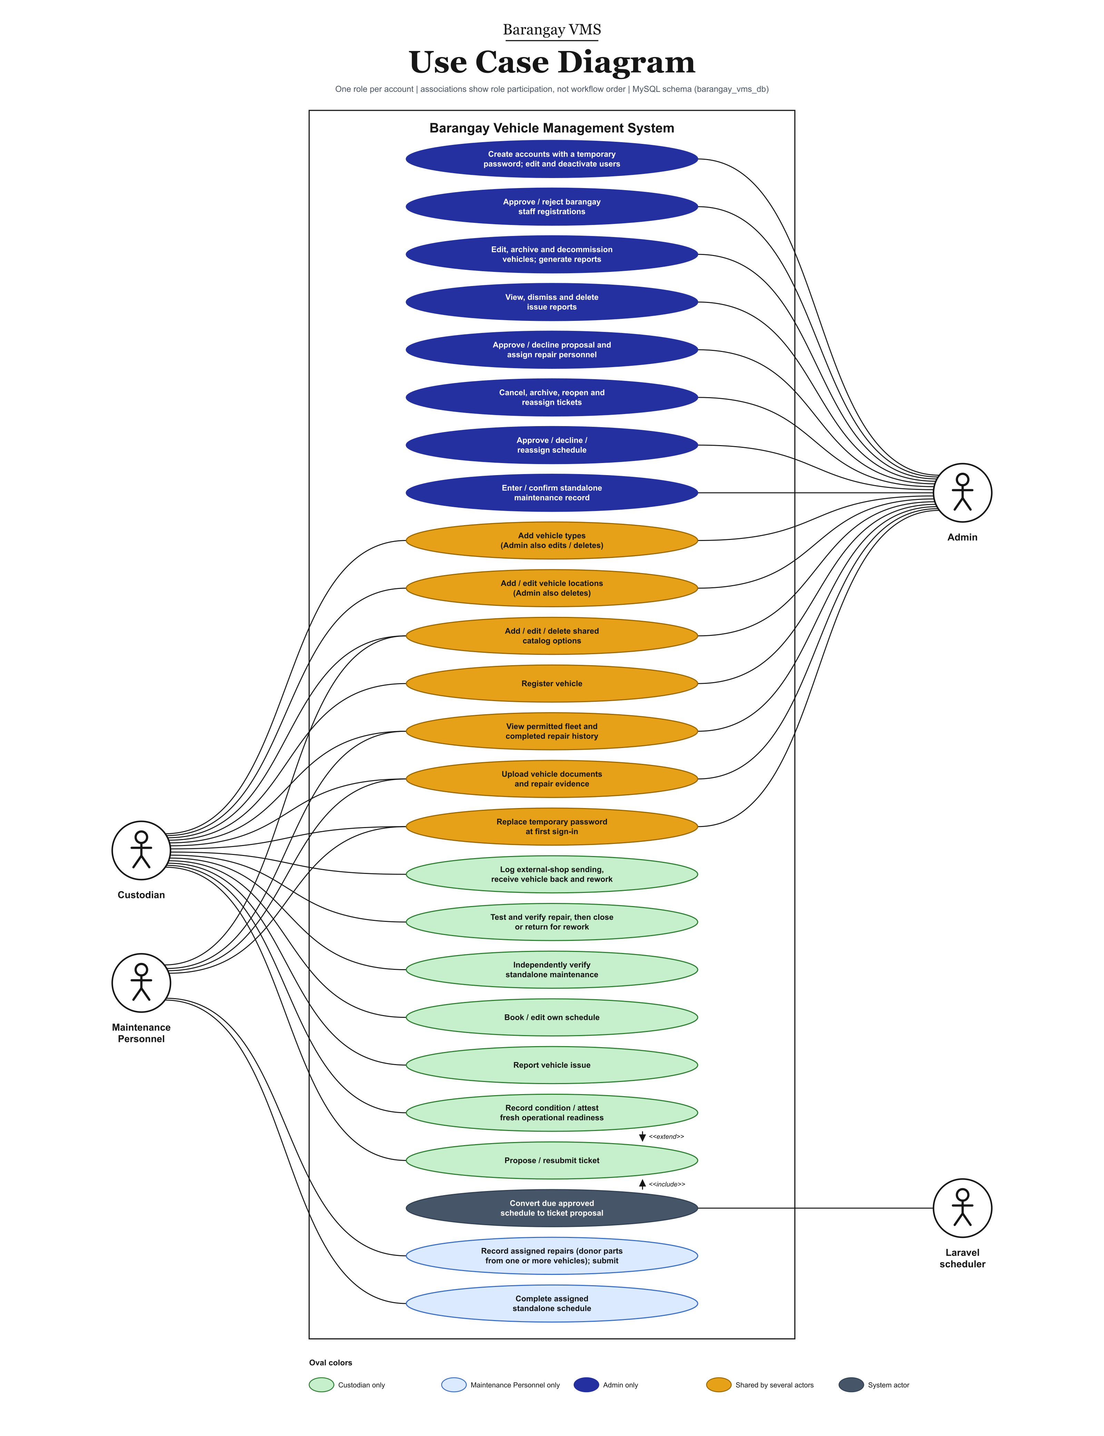

09 REQUIREMENTS
Use case diagram: fleet and maintenance
Admin
• Approves or declines ticket proposals, including shop jobs
• Assigns maintenance personnel; manages accounts and reports
Custodian
• Reports issues; proposes tickets
• Logs jobs sent to the shop and receives them back
• Tests and verifies the repair, then closes the ticket
Maintenance Personnel
• Performs assigned repairs and logs parts, including donor parts
• Completes assigned schedules
Laravel scheduler
• Turns due approved schedules into ticket proposals

Slide 12
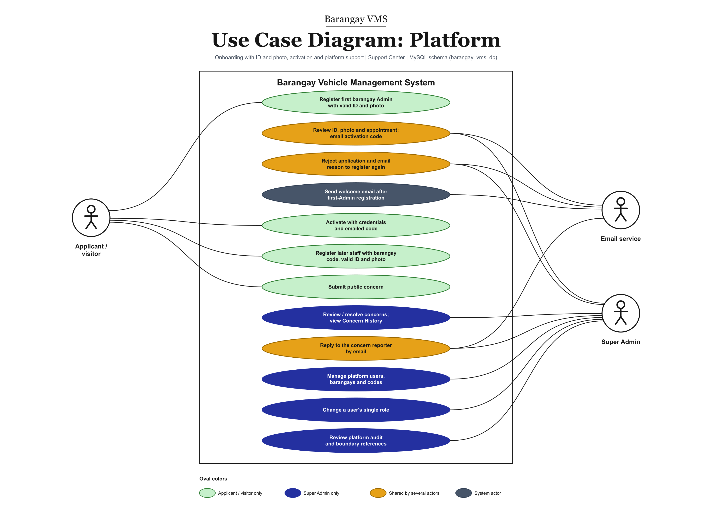
09 REQUIREMENTS
Use case diagram: onboarding and platform
Applicant
• Registers with a valid ID and photo
• Activates with the staff code from the Super Admin
Super Admin
• Reviews and approves registrations
• Sends staff codes and replies to concerns by e-mail
• Changes a user’s single role
E-mail service
• Gmail SMTP sends welcome, code and outcome e-mails

Slide 13
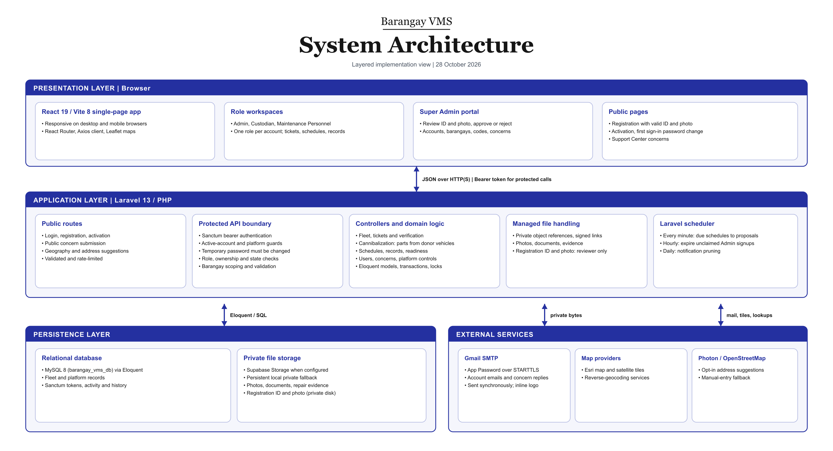

10 DESIGN
System architecture diagram

Slide 14
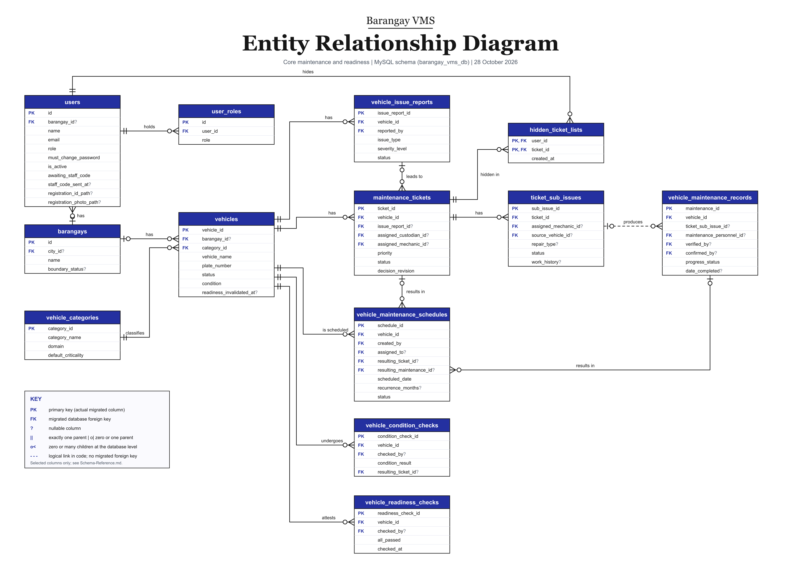
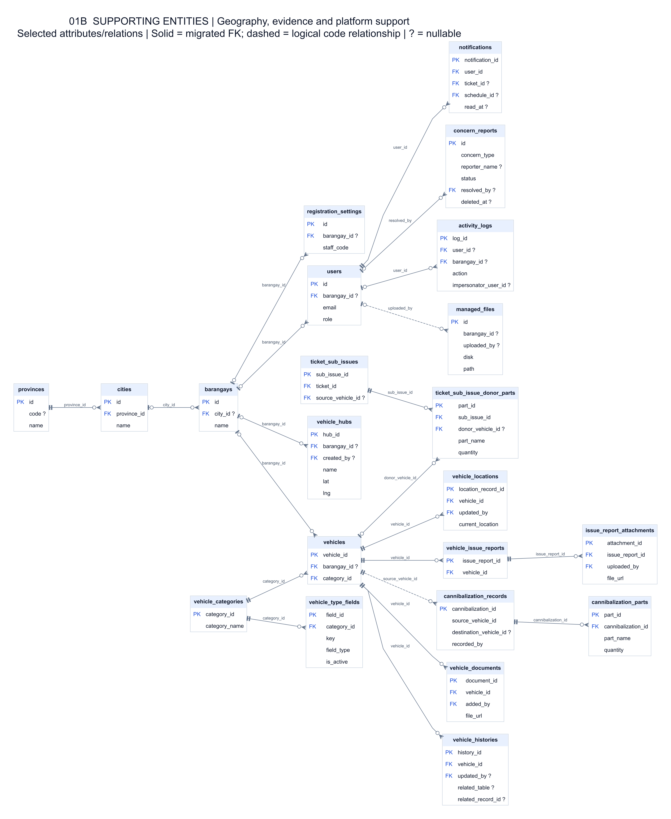

11 DATA
Entity relationship diagram
Core maintenance and readiness (47 tables in total)
Supporting entities

Slide 15
12 LIVE DEMONSTRATION
Demo: the core workflow
Custodian reports an issue and sets a maintenance schedule
CUSTODIAN
1
Proposes it in-house or sent to an external shop
Admin approves the ticket
ADMIN
2
Assigns a mechanic, or approves the shop job
Maintenance personnel performs the repair
MAINTENANCE
3
Logs work and parts used
Custodian verifies the work and closes the ticket
CUSTODIAN
4
Satisfactory: closed and archived. Otherwise: rework
Thank you. Questions?
Setup steps (barangay registration, accounts, vehicle) are in the complete demo workflow PDF.

